Slide 1


COVID-19 Clinical Trials EDA

Slide 2
COVID-19 Clinical Trials EDA

Slide 3


COVID-19 Clinical Trials EDA
Problem Statement
Problem
Statement
Objective: To explore the characteristics of COVID-19 clinical trials, including status, phases, study designs, and demographics, using a dataset from ClinicalTrials.gov.
Dataset Source: ClinicalTrials.gov, maintained by the U.S. National Library of Medicine, providing publicly available data on clinical studies worldwide.
Dataset Description: Consists of XML files (each representing a study with a unique NCT number) and a CSV file with key trial information.
Context: The global COVID-19 pandemic necessitated rapid development and evaluation of treatments, vaccines, and interventions through clinical trials.
Problem: Understanding the landscape of COVID-19 clinical trials is critical to identify trends, gaps, and opportunities for medical research and policy-making.
Goal: Perform Exploratory Data Analysis (EDA) to uncover insights into trial statuses, phases, participant demographics, and temporal trends.
Importance: Insights can guide researchers, healthcare providers, and policymakers in prioritizing resources and designing future studies.

Slide 4


COVID-19 Clinical Trials EDA
Dataset Overview
Problem
Statement
Objective: To explore the characteristics of COVID-19 clinical trials, including status, phases, study designs, and demographics, using a dataset from ClinicalTrials.gov.
Dataset Source: ClinicalTrials.gov, maintained by the U.S. National Library of Medicine, providing publicly available data on clinical studies worldwide.
Dataset Description: Consists of XML files (each representing a study with a unique NCT number) and a CSV file with key trial information.
Context: The global COVID-19 pandemic necessitated rapid development and evaluation of treatments, vaccines, and interventions through clinical trials.
Problem: Understanding the landscape of COVID-19 clinical trials is critical to identify trends, gaps, and opportunities for medical research and policy-making.
Goal: Perform Exploratory Data Analysis (EDA) to uncover insights into trial statuses, phases, participant demographics, and temporal trends.
Importance: Insights can guide researchers, healthcare providers, and policymakers in prioritizing resources and designing future studies.

Slide 5

COVID-19 Clinical Trials EDA
Techniques Used - Data Loading and Initial Exploration
Problem
Statement
Dataset Overview
Data Structure: The dataset includes a CSV file (covid_clinical_trials.csv) with columns like Status, Phases, Age, Start Date, and Outcome Measures, alongside XML files for detailed study information.
Key Features:
NCT Number: Unique identifier for each trial.
Status: Indicates trial progress (e.g., Completed, Recruiting).
Phases: Trial phase (e.g., Phase 1, Phase 2).
Start Date: When the trial began.
Demographics: Age and gender distributions.
Challenges: Missing data, inconsistent date formats, and the need to preprocess categorical variables for analysis.
Context: The global COVID-19 pandemic necessitated rapid development and evaluation of treatments, vaccines, and interventions through clinical trials.
Problem: Understanding the landscape of COVID-19 clinical trials is critical to identify trends, gaps, and opportunities for medical research and policy-making.
Goal: Perform Exploratory Data Analysis (EDA) to uncover insights into trial statuses, phases, participant demographics, and temporal trends.
Importance: Insights can guide researchers, healthcare providers, and policymakers in prioritizing resources and designing future studies.

Slide 6
COVID-19 Clinical Trials EDA
Dataset Overview
Techniques Used - Data Loading and Initial Exploration
Data Structure: The dataset includes a CSV file (covid_clinical_trials.csv) with columns like Status, Phases, Age, Start Date, and Outcome Measures, alongside XML files for detailed study information.
Key Features:
NCT Number: Unique identifier for each trial.
Status: Indicates trial progress (e.g., Completed, Recruiting).
Phases: Trial phase (e.g., Phase 1, Phase 2).
Start Date: When the trial began.
Demographics: Age and gender distributions.
Challenges: Missing data, inconsistent date formats, and the need to preprocess categorical variables for analysis.
print(df.head()): This displays the first 5 rows of the DataFrame df. It's useful for a quick preview of the data.
print(df.info()): This provides a concise summary of the DataFrame, including the number of rows and columns, data types of each column, and the memory usage. It helps understand the structure and characteristics of your data.
print(df.describe()): This generates descriptive statistics for numerical columns in the DataFrame, including count, mean, standard deviation, minimum, quartiles, and maximum. It gives a quick overview of the central tendency and dispersion of your numerical data.
Initial Exploration:
Displayed first few rows: df.head().
Checked data types and missing values: df.info().
Generated summary statistics: df.describe().
Purpose: Understand dataset structure, identify missing data, and verify data integrity.
Libraries: Utilized Python libraries including Pandas for data manipulation, NumPy for numerical operations, Seaborn, and Matplotlib for visualizations.
Loading Data:
python
python
import pandas as pd
Import numpy as np
Import math.plotlib as plt
df = pd.read_csv('covid_clinical_trials.csv')
print(df.head())
print(df.info())
print(df.describe())

Slide 7
COVID-19 Clinical Trials EDA
df.shape returns a tuple representing the dimensions of the DataFrame df. The tuple contains two elements: (number_of_rows, number_of_columns). For This project this will be (5783, 27)
Dataset Overview
Techniques Used - Data Loading and Initial Exploration
Data Structure: The dataset includes a CSV file (covid_clinical_trials.csv) with columns like Status, Phases, Age, Start Date, and Outcome Measures, alongside XML files for detailed study information.
Key Features:
NCT Number: Unique identifier for each trial.
Status: Indicates trial progress (e.g., Completed, Recruiting).
Phases: Trial phase (e.g., Phase 1, Phase 2).
Start Date: When the trial began.
Demographics: Age and gender distributions.
Challenges: Missing data, inconsistent date formats, and the need to preprocess categorical variables for analysis.
print(df.head()): This displays the first 5 rows of the DataFrame df. It's useful for a quick preview of the data.
print(df.info()): This provides a concise summary of the DataFrame, including the number of rows and columns, data types of each column, and the memory usage. It helps understand the structure and characteristics of your data.
print(df.describe()): This generates descriptive statistics for numerical columns in the DataFrame, including count, mean, standard deviation, minimum, quartiles, and maximum. It gives a quick overview of the central tendency and dispersion of your numerical data.
Initial Exploration:
Displayed first few rows: df.head().
Checked data types and missing values: df.info().
Generated summary statistics: df.describe().
Purpose: Understand dataset structure, identify missing data, and verify data integrity.
python
print(df.shape)
python
print(df.head())
print(df.info())
print(df.describe())
Libraries: Utilized Python libraries including Pandas for data manipulation, NumPy for numerical operations, Seaborn, and Matplotlib for visualizations.
Loading Data:
python
import pandas as pd
Import numpy as np
Import math.plotlib as plt
df = pd.read_csv('covid_clinical_trials.csv')

Slide 8
COVID-19 Clinical Trials EDA
Libraries: Utilized Python libraries including Pandas for data manipulation, NumPy for numerical operations, Seaborn, and Matplotlib for visualizations.
Loading Data:
print(df.head()): This displays the first 5 rows of the DataFrame df. It's useful for a quick preview of the data.
print(df.info()): This provides a concise summary of the DataFrame, including the number of rows and columns, data types of each column, and the memory usage. It helps understand the structure and characteristics of your data.
print(df.describe()): This generates descriptive statistics for numerical columns in the DataFrame, including count, mean, standard deviation, minimum, quartiles, and maximum. It gives a quick overview of the central tendency and dispersion of your numerical data.
python
Initial Exploration:
Displayed first few rows: df.head().
Checked data types and missing values: df.info().
Generated summary statistics: df.describe().
Purpose: Understand dataset structure, identify missing data, and verify data integrity.
import pandas as pd
Import numpy as np
Import math.plotlib as plt
df = pd.read_csv('covid_clinical_trials.csv')
python
print(df.head())
print(df.info())
print(df.describe())

Slide 9

COVID-19 Clinical Trials EDA
Data Cleaning
Data cleaning is a critical first step – some estimate it can take up to 80% of a data project’s In this phase, we will load the dataset, inspect it, handle missing values, and correct inconsistent data types. Ensuring clean data will make the analysis easier and more reliable.
Understand missing data – Check how many values are missing in each column:columns with a lot of NaN (missing) values In this dataset, you might find that columns like “Acronym”, “Study Documents”, or “Results First Posted” are largely empty.
For Our Dataset We used isnull function and sum function to find the total number of null values in each tuple: the result: Rank 0
NCT Number 0
Title 0
Acronym 3303
Status 0
Study Results 0
Conditions 0
Interventions 886
Outcome Measures 35
Sponsor/Collaborators 0
Gender 10
Age 0
Phases 2461
Enrollment 34
Funded Bys 0
Study Type 0
Study Designs 35
Other IDs 1
Start Date 34
Primary Completion Date 36
Completion Date 36
First Posted 0
Results First Posted 5747
Last Update Posted 0
Locations 585
Study Documents 5601
URL 0

Slide 10
COVID-19 Clinical Trials EDA
Data Cleaning
For Our Dataset We used isnull function and sum function to find the total number of null values in each tuple: the result: Rank 0
NCT Number 0
Title 0
Acronym 3303
Status 0
Study Results 0
Conditions 0
Interventions 886
Outcome Measures 35
Sponsor/Collaborators 0
Gender 10
Age 0
Phases 2461
Enrollment 34
Funded Bys 0
Study Type 0
Study Designs 35
Other IDs 1
Start Date 34
Primary Completion Date 36
Completion Date 36
First Posted 0
Results First Posted 5747
Last Update Posted 0
Locations 585
Study Documents 5601
URL 0
Data cleaning is a critical first step – some estimate it can take up to 80% of a data project’s In this phase, we will load the dataset, inspect it, handle missing values, and correct inconsistent data types. Ensuring clean data will make the analysis easier and more reliable.
Understand missing data – Check how many values are missing in each column:columns with a lot of NaN (missing) values In this dataset, you might find that columns like “Acronym”, “Study Documents”, or “Results First Posted” are largely empty.
Most dataset columns, like Rank, NCT Number, and Title, are complete. Significant missing data occurs in Results First Posted, Study Documents, Acronym, and Phases. Interventions and Locations have moderate gaps, while Outcome Measures, Study Designs, and others show minimal missing values. Targeted data handling is needed for high-missing-value columns.
Acronym (shorthand for study titles) or Study Documents (links to PDFs) might not be needed for our analysis then we shall remove it
Fill missing Phase info with "Not Applicable“
Fill missing Enrollment with 0
convert valid date strings to actual datetime objects, and turn invalid or missing dates into NaT (pandas’ “Not a Time” value).

Slide 11
COVID-19 Clinical Trials EDA
For Our Dataset We used isnull function and sum function to find the total number of null values in each tuple: the result: Rank 0
NCT Number 0
Title 0
Acronym 3303
Status 0
Study Results 0
Conditions 0
Interventions 886
Outcome Measures 35
Sponsor/Collaborators 0
Gender 10
Age 0
Phases 2461
Enrollment 34
Funded Bys 0
Study Type 0
Study Designs 35
Other IDs 1
Start Date 34
Primary Completion Date 36
Completion Date 36
First Posted 0
Results First Posted 5747
Last Update Posted 0
Locations 585
Study Documents 5601
URL 0
Data Cleaning
Data cleaning is a critical first step – some estimate it can take up to 80% of a data project’s In this phase, we will load the dataset, inspect it, handle missing values, and correct inconsistent data types. Ensuring clean data will make the analysis easier and more reliable.
Most dataset columns, like Rank, NCT Number, and Title, are complete. Significant missing data occurs in Results First Posted, Study Documents, Acronym, and Phases. Interventions and Locations have moderate gaps, while Outcome Measures, Study Designs, and others show minimal missing values. Targeted data handling is needed for high-missing-value columns.
Understand missing data – Check how many values are missing in each column:columns with a lot of NaN (missing) values In this dataset, you might find that columns like “Acronym”, “Study Documents”, or “Results First Posted” are largely empty.
Acronym (shorthand for study titles) or Study Documents (links to PDFs) might not be needed for our analysis then we shall remove it
Fill missing Phase info with "Not Applicable“
Fill missing Enrollment with 0
convert valid date strings to actual datetime objects, and turn invalid or missing dates into NaT (pandas’ “Not a Time” value).

Slide 12
For Our Dataset We used isnull function and sum function to find the total number of null values in each tuple: the result: Rank 0
NCT Number 0
Title 0
Acronym 3303
Status 0
Study Results 0
Conditions 0
Interventions 886
Outcome Measures 35
Sponsor/Collaborators 0
Gender 10
Age 0
Phases 2461
Enrollment 34
Funded Bys 0
Study Type 0
Study Designs 35
Other IDs 1
Start Date 34
Primary Completion Date 36
Completion Date 36
First Posted 0
Results First Posted 5747
Last Update Posted 0
Locations 585
Study Documents 5601
URL 0
COVID-19 Clinical Trials EDA
Data Cleaning
Most dataset columns, like Rank, NCT Number, and Title, are complete. Significant missing data occurs in Results First Posted, Study Documents, Acronym, and Phases. Interventions and Locations have moderate gaps, while Outcome Measures, Study Designs, and others show minimal missing values. Targeted data handling is needed for high-missing-value columns.
Data cleaning is a critical first step – some estimate it can take up to 80% of a data project’s In this phase, we will load the dataset, inspect it, handle missing values, and correct inconsistent data types. Ensuring clean data will make the analysis easier and more reliable.
Acronym (shorthand for study titles) or Study Documents (links to PDFs) might not be needed for our analysis then we shall remove it
Understand missing data – Check how many values are missing in each column:columns with a lot of NaN (missing) values In this dataset, you might find that columns like “Acronym”, “Study Documents”, or “Results First Posted” are largely empty.
Fill missing Phase info with "Not Applicable“
Fill missing Enrollment with 0
convert valid date strings to actual datetime objects, and turn invalid or missing dates into NaT (pandas’ “Not a Time” value).

Slide 13
COVID-19 Clinical Trials EDA
Most dataset columns, like Rank, NCT Number, and Title, are complete. Significant missing data occurs in Results First Posted, Study Documents, Acronym, and Phases. Interventions and Locations have moderate gaps, while Outcome Measures, Study Designs, and others show minimal missing values. Targeted data handling is needed for high-missing-value columns.
Data Cleaning
Acronym (shorthand for study titles) or Study Documents (links to PDFs) might not be needed for our analysis then we shall remove it
Data cleaning is a critical first step – some estimate it can take up to 80% of a data project’s In this phase, we will load the dataset, inspect it, handle missing values, and correct inconsistent data types. Ensuring clean data will make the analysis easier and more reliable.
Fill missing Phase info with "Not Applicable“
Fill missing Enrollment with 0
convert valid date strings to actual datetime objects, and turn invalid or missing dates into NaT (pandas’ “Not a Time” value).
Understand missing data – Check how many values are missing in each column:columns with a lot of NaN (missing) values In this dataset, you might find that columns like “Acronym”, “Study Documents”, or “Results First Posted” are largely empty.

Slide 14
COVID-19 Clinical Trials EDA
Most dataset columns, like Rank, NCT Number, and Title, are complete. Significant missing data occurs in Results First Posted, Study Documents, Acronym, and Phases. Interventions and Locations have moderate gaps, while Outcome Measures, Study Designs, and others show minimal missing values. Targeted data handling is needed for high-missing-value columns.
Acronym (shorthand for study titles) or Study Documents (links to PDFs) might not be needed for our analysis then we shall remove it
Fill missing Phase info with "Not Applicable“
Fill missing Enrollment with 0
convert valid date strings to actual datetime objects, and turn invalid or missing dates into NaT (pandas’ “Not a Time” value).
Data Cleaning
python
data['Phases']=data['Phases'].fillna('Not Applicable')
data['Enrollment']=data['Enrollment'].fillna(0)
data['Completion Date']=pd.to_datetime(data['Completion Date'],errors="coerce")
data['Primary Completion Date']=pd.to_datetime(data['Primary Completion Date'],errors='coerce')
data['Start Date']=pd.to_datetime( data['Start Date'],errors="coerce")
#More Cleaning
data.dropna(subset=['Interventions','Outcome Measures','Gender','Study Designs','Other IDs','Start Date’, 'Completion Date’, 'Primary Completion Date‘],inplace=True)
data['Locations']=data['Locations'].fillna("Remote")

Slide 15
COVID-19 Clinical Trials EDA
Most dataset columns, like Rank, NCT Number, and Title, are complete. Significant missing data occurs in Results First Posted, Study Documents, Acronym, and Phases. Interventions and Locations have moderate gaps, while Outcome Measures, Study Designs, and others show minimal missing values. Targeted data handling is needed for high-missing-value columns.
Acronym (shorthand for study titles) or Study Documents (links to PDFs) might not be needed for our analysis then we shall remove it
Data Cleaning
Feature Additions
python
Feature addition is a key step in data preprocessing and analysis. It helps enrich the dataset by creating new columns based on existing data or external inputs.
python
data['Phases']=data['Phases'].fillna('Not Applicable')
data['Enrollment']=data['Enrollment'].fillna(0)
data['Completion Date']=pd.to_datetime(data['Completion Date'],errors="coerce")
data['Primary Completion Date']=pd.to_datetime(data['Primary Completion Date'],errors='coerce')
data['Start Date']=pd.to_datetime( data['Start Date'],errors="coerce")
#More Cleaning
data.dropna(subset=['Interventions','Outcome Measures','Gender','Study Designs','Other IDs','Start Date’, 'Completion Date’, 'Primary Completion Date‘],inplace=True)
data['Locations']=data['Locations'].fillna("Remote")
data['Countries'] =data['Locations'].apply(extract_countries)
data['Duration']=calculate_duration(data['Start Date'],data['Completion Date’])
data['Interventions Types']=data['Interventions'].apply(extract_intervention_types)
For our Dataset we have added 3 columns which can be used group and validate our data .The fields are
Interventions Types
Duration
Countries

Slide 16
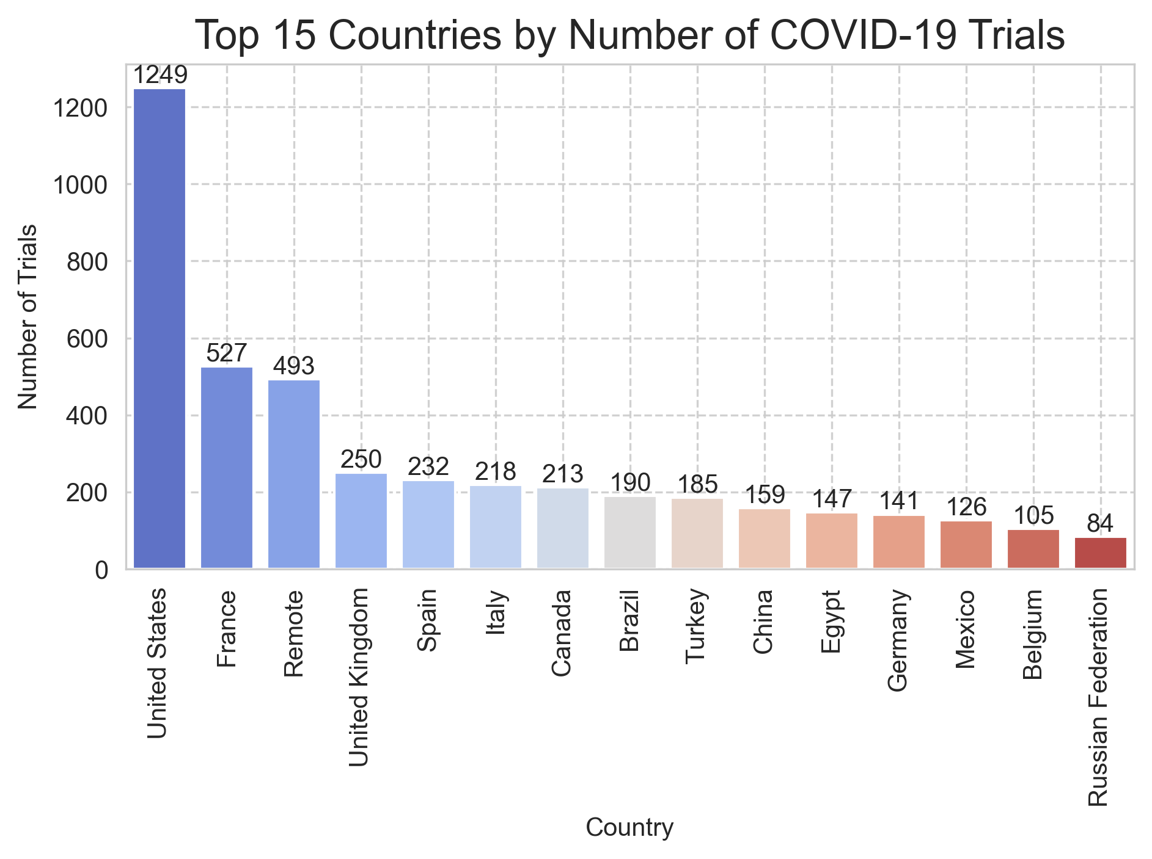
COVID-19 Clinical Trials EDA
Most dataset columns, like Rank, NCT Number, and Title, are complete. Significant missing data occurs in Results First Posted, Study Documents, Acronym, and Phases. Interventions and Locations have moderate gaps, while Outcome Measures, Study Designs, and others show minimal missing values. Targeted data handling is needed for high-missing-value columns.
Acronym (shorthand for study titles) or Study Documents (links to PDFs) might not be needed for our analysis then we shall remove it
Feature Additions
Analysis (Top 15 Countries by Number of COVID-19 Trials)
python
python
Feature addition is a key step in data preprocessing and analysis. It helps enrich the dataset by creating new columns based on existing data or external inputs.
# Flatten the list of country lists
all_countries = [country for sublist in data['Countries'] for country in sublist]
country_count = Counter(all_countries)
# Convert to DataFrame and get top 15
top15_df = pd.DataFrame(country_count.items(), columns=['Country', 'Count'])
top15_df = top15_df.sort_values(by='Count', ascending=False).head(15)
# Plotting
sns.set_style('whitegrid')
# plt.figure(figsize=(12, 7))
plt.title("Top 15 Countries by Number of COVID-19 Trials", fontsize=16)
# Barplot with hue same as x just for coloring
ax = sns.barplot(data=top15_df, x='Country', y='Count', hue='Country', dodge=False, palette='coolwarm')
# Add labels above bars
for bar in ax.patches:
height = bar.get_height()
ax.text(
bar.get_x() + bar.get_width() / 2,
height + 1,
f'{int(height)}',
ha='center', va='bottom', fontsize=10
)
# Customize
plt.ylabel("Number of Trials")
plt.xticks(rotation=90)
plt.grid(True, linestyle="--", alpha=0.9)
plt.tight_layout()
plt.savefig('Top 15 Countries by Number of COVID-19 Trials.png', dpi=300, bbox_inches='tight')
plt.show()
data['Countries'] =data['Locations'].apply(extract_countries)
data['Duration']=calculate_duration(data['Start Date'],data['Completion Date’])
data['Interventions Types']=data['Interventions'].apply(extract_intervention_types)
For our Dataset we have added 3 columns which can be used group and validate our data .The fields are
Interventions Types
Duration
Countries

Slide 17
COVID-19 Clinical Trials EDA
Most dataset columns, like Rank, NCT Number, and Title, are complete. Significant missing data occurs in Results First Posted, Study Documents, Acronym, and Phases. Interventions and Locations have moderate gaps, while Outcome Measures, Study Designs, and others show minimal missing values. Targeted data handling is needed for high-missing-value columns.
python
data['Countries'] =data['Locations'].apply(extract_countries)
data['Duration']=calculate_duration(data['Start Date'],data['Completion Date’])
data['Interventions Types']=data['Interventions'].apply(extract_intervention_types)
Acronym (shorthand for study titles) or Study Documents (links to PDFs) might not be needed for our analysis then we shall remove it
Feature Additions
Analysis (Top 15 Countries by Number of COVID-19 Trials)
python
python
Feature addition is a key step in data preprocessing and analysis. It helps enrich the dataset by creating new columns based on existing data or external inputs.
# Flatten the list of country lists
all_countries = [country for sublist in data['Countries'] for country in sublist]
country_count = Counter(all_countries)
# Convert to DataFrame and get top 15
top15_df = pd.DataFrame(country_count.items(), columns=['Country', 'Count'])
top15_df = top15_df.sort_values(by='Count', ascending=False).head(15)
# Plotting
sns.set_style('whitegrid')
# plt.figure(figsize=(12, 7))
plt.title("Top 15 Countries by Number of COVID-19 Trials", fontsize=16)
# Barplot with hue same as x just for coloring
ax = sns.barplot(data=top15_df, x='Country', y='Count', hue='Country', dodge=False, palette='coolwarm')
# Add labels above bars
for bar in ax.patches:
height = bar.get_height()
ax.text(
bar.get_x() + bar.get_width() / 2,
height + 1,
f'{int(height)}',
ha='center', va='bottom', fontsize=10
)
# Customize
plt.ylabel("Number of Trials")
plt.xticks(rotation=90)
plt.grid(True, linestyle="--", alpha=0.9)
plt.tight_layout()
plt.savefig('Top 15 Countries by Number of COVID-19 Trials.png', dpi=300, bbox_inches='tight')
plt.show()
all_intervenion = [item for items in data['Interventions Types'] for item in items]
intervention_count = Counter(all_intervenion)
mc=pd.DataFrame(intervention_count.items(),columns=['type','count'])
mc=mc.sort_values(by='count', ascending=False)
sns.set_style('whitegrid')
# plt.figure(figsize=(12, 7))
plt.title("Most Commonly used Interventions", fontsize=16)
ax = sns.barplot(data=mc,x='type',y='count',hue="type",palette='coolwarm')
for bar in ax.patches:
height=bar.get_height()
ax.text(
bar.get_x() + bar.get_width()/2,
height + 1,
f'{int(height)}',
ha="center",va="bottom",fontsize=10
)
plt.ylabel('Number of Interventions')
plt.xlabel('Types of Interventions')
plt.xticks(rotation=-90)
plt.grid(True,linestyle="--",alpha=0.8)
plt.savefig("Most Commonly used Interventions",dpi=300,bbox_inches='tight')
plt.show()
For our Dataset we have added 3 columns which can be used group and validate our data .The fields are
Interventions Types
Duration
Countries

Slide 18
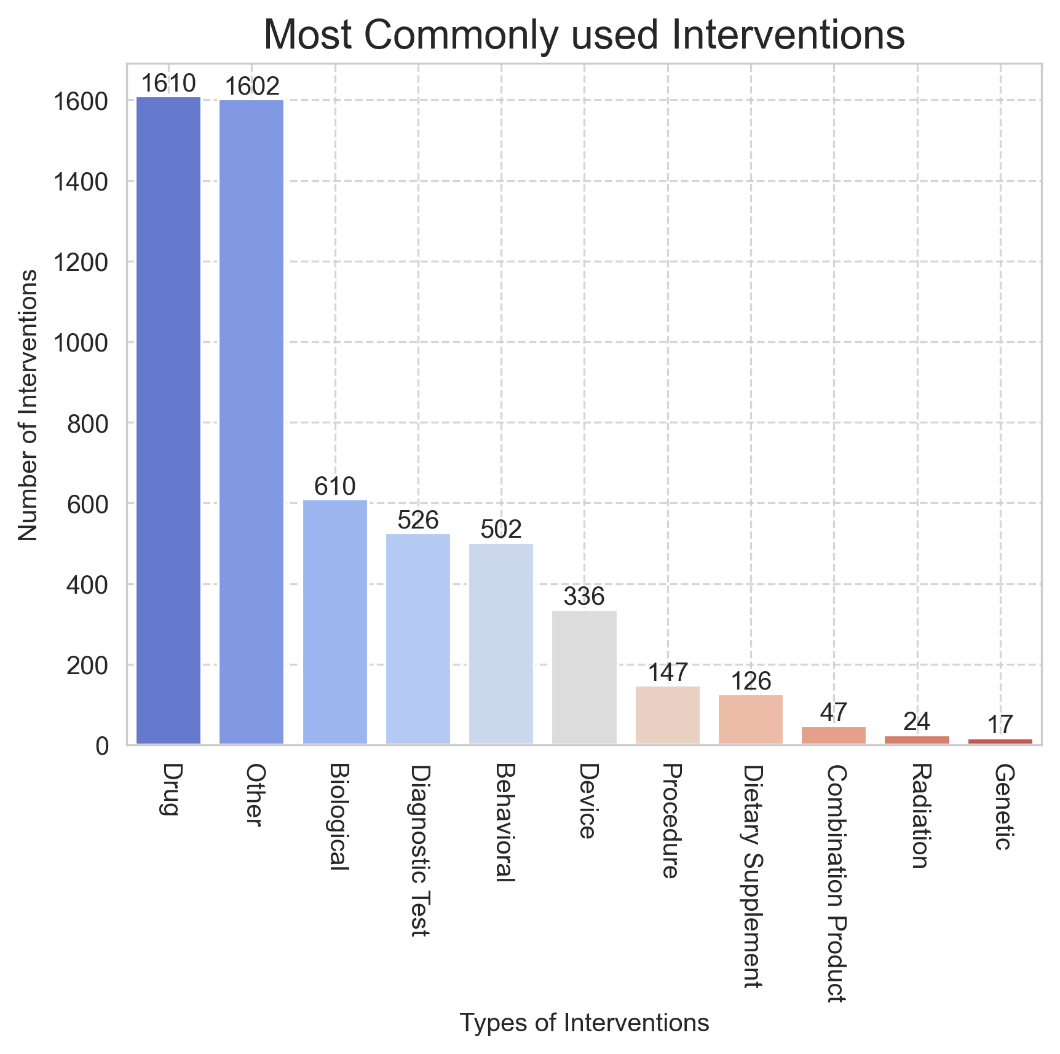
COVID-19 Clinical Trials EDA
Most dataset columns, like Rank, NCT Number, and Title, are complete. Significant missing data occurs in Results First Posted, Study Documents, Acronym, and Phases. Interventions and Locations have moderate gaps, while Outcome Measures, Study Designs, and others show minimal missing values. Targeted data handling is needed for high-missing-value columns.
python
data['Countries'] =data['Locations'].apply(extract_countries)
data['Duration']=calculate_duration(data['Start Date'],data['Completion Date’])
data['Interventions Types']=data['Interventions'].apply(extract_intervention_types)
Acronym (shorthand for study titles) or Study Documents (links to PDFs) might not be needed for our analysis then we shall remove it
Analysis (Most Commonly used Intervention)
python
python
# Flatten the list of country lists
all_countries = [country for sublist in data['Countries'] for country in sublist]
country_count = Counter(all_countries)
# Convert to DataFrame and get top 15
top15_df = pd.DataFrame(country_count.items(), columns=['Country', 'Count'])
top15_df = top15_df.sort_values(by='Count', ascending=False).head(15)
# Plotting
sns.set_style('whitegrid')
# plt.figure(figsize=(12, 7))
plt.title("Top 15 Countries by Number of COVID-19 Trials", fontsize=16)
# Barplot with hue same as x just for coloring
ax = sns.barplot(data=top15_df, x='Country', y='Count', hue='Country', dodge=False, palette='coolwarm')
# Add labels above bars
for bar in ax.patches:
height = bar.get_height()
ax.text(
bar.get_x() + bar.get_width() / 2,
height + 1,
f'{int(height)}',
ha='center', va='bottom', fontsize=10
)
# Customize
plt.ylabel("Number of Trials")
plt.xticks(rotation=90)
plt.grid(True, linestyle="--", alpha=0.9)
plt.tight_layout()
plt.savefig('Top 15 Countries by Number of COVID-19 Trials.png', dpi=300, bbox_inches='tight')
plt.show()
all_intervenion = [item for items in data['Interventions Types'] for item in items]
intervention_count = Counter(all_intervenion)
mc=pd.DataFrame(intervention_count.items(),columns=['type','count'])
mc=mc.sort_values(by='count', ascending=False)
sns.set_style('whitegrid')
# plt.figure(figsize=(12, 7))
plt.title("Most Commonly used Interventions", fontsize=16)
ax = sns.barplot(data=mc,x='type',y='count',hue="type",palette='coolwarm')
for bar in ax.patches:
height=bar.get_height()
ax.text(
bar.get_x() + bar.get_width()/2,
height + 1,
f'{int(height)}',
ha="center",va="bottom",fontsize=10
)
plt.ylabel('Number of Interventions')
plt.xlabel('Types of Interventions')
plt.xticks(rotation=-90)
plt.grid(True,linestyle="--",alpha=0.8)
plt.savefig("Most Commonly used Interventions",dpi=300,bbox_inches='tight')
plt.show()

Slide 19
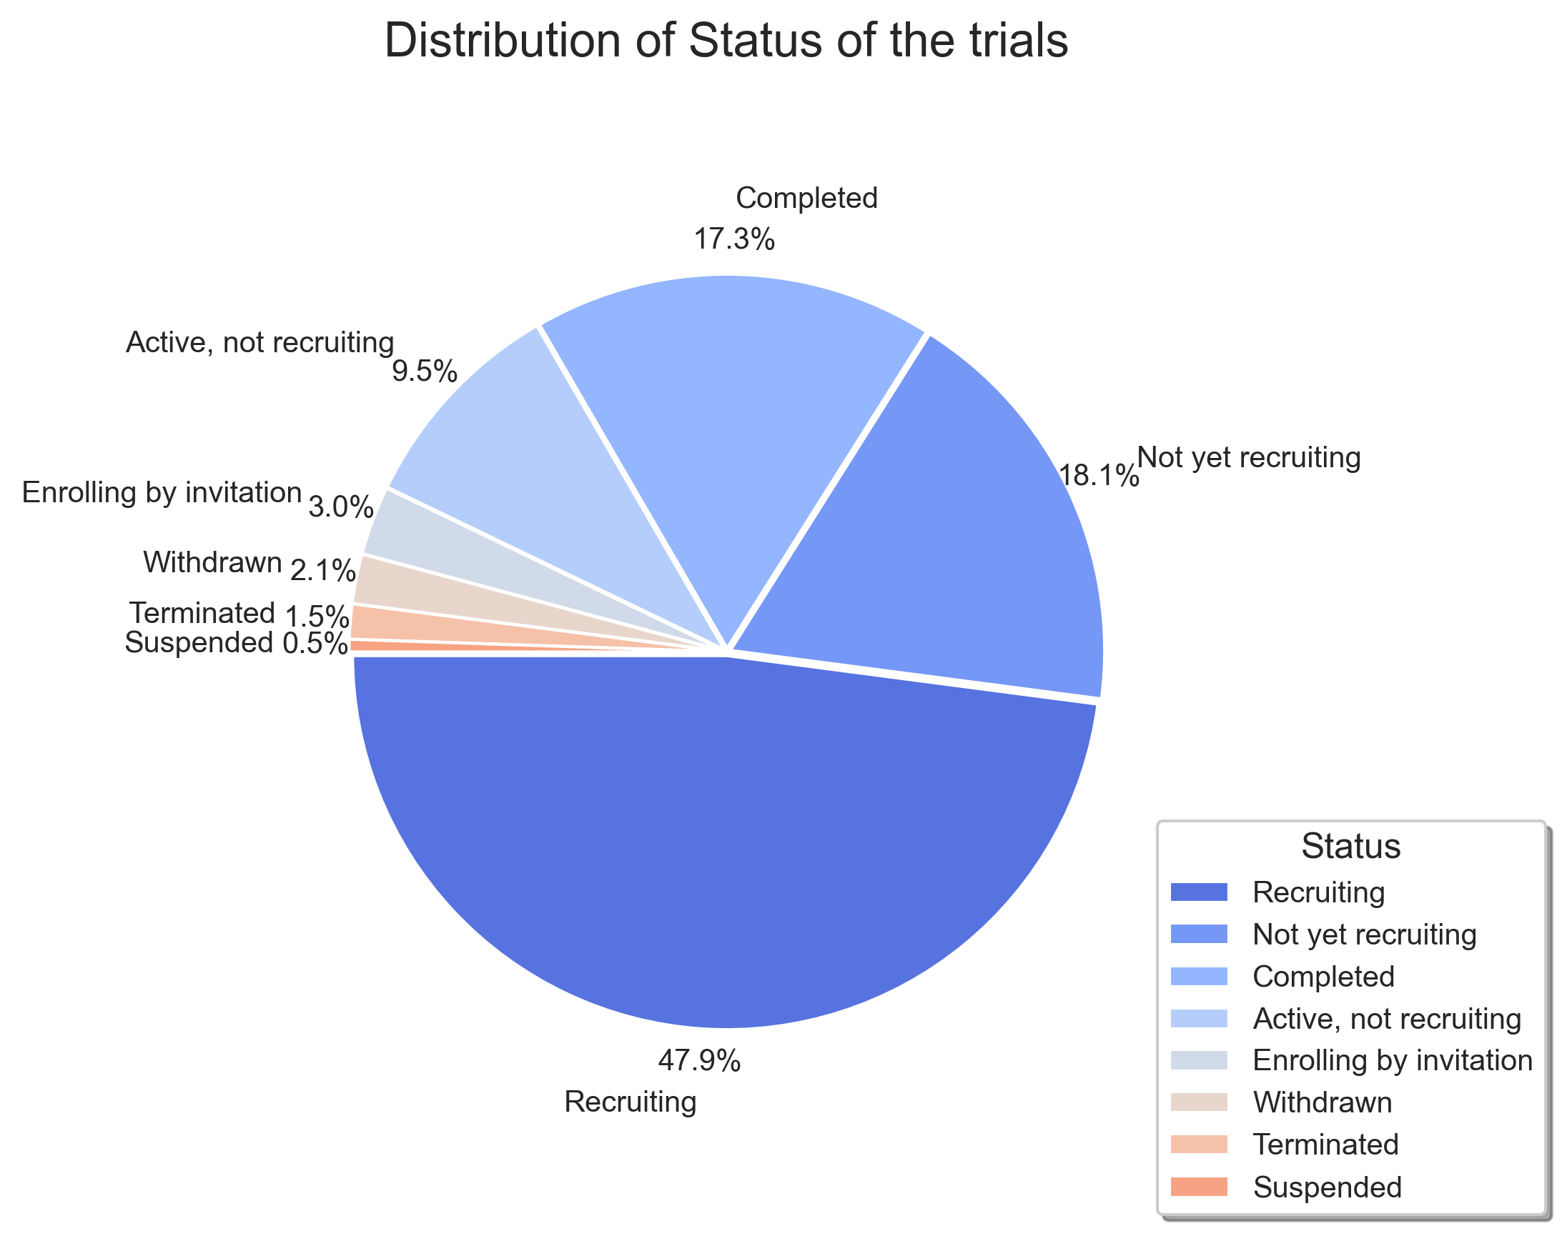
COVID-19 Clinical Trials EDA
Most dataset columns, like Rank, NCT Number, and Title, are complete. Significant missing data occurs in Results First Posted, Study Documents, Acronym, and Phases. Interventions and Locations have moderate gaps, while Outcome Measures, Study Designs, and others show minimal missing values. Targeted data handling is needed for high-missing-value columns.
python
data['Countries'] =data['Locations'].apply(extract_countries)
data['Duration']=calculate_duration(data['Start Date'],data['Completion Date’])
data['Interventions Types']=data['Interventions'].apply(extract_intervention_types)
Acronym (shorthand for study titles) or Study Documents (links to PDFs) might not be needed for our analysis then we shall remove it
Analysis (Most Commonly used Intervention)
Similarly, we can conduct on various terms such as
python
python
# Flatten the list of country lists
all_countries = [country for sublist in data['Countries'] for country in sublist]
country_count = Counter(all_countries)
# Convert to DataFrame and get top 15
top15_df = pd.DataFrame(country_count.items(), columns=['Country', 'Count'])
top15_df = top15_df.sort_values(by='Count', ascending=False).head(15)
# Plotting
sns.set_style('whitegrid')
# plt.figure(figsize=(12, 7))
plt.title("Top 15 Countries by Number of COVID-19 Trials", fontsize=16)
# Barplot with hue same as x just for coloring
ax = sns.barplot(data=top15_df, x='Country', y='Count', hue='Country', dodge=False, palette='coolwarm')
# Add labels above bars
for bar in ax.patches:
height = bar.get_height()
ax.text(
bar.get_x() + bar.get_width() / 2,
height + 1,
f'{int(height)}',
ha='center', va='bottom', fontsize=10
)
# Customize
plt.ylabel("Number of Trials")
plt.xticks(rotation=90)
plt.grid(True, linestyle="--", alpha=0.9)
plt.tight_layout()
plt.savefig('Top 15 Countries by Number of COVID-19 Trials.png', dpi=300, bbox_inches='tight')
plt.show()
all_intervenion = [item for items in data['Interventions Types'] for item in items]
intervention_count = Counter(all_intervenion)
mc=pd.DataFrame(intervention_count.items(),columns=['type','count'])
mc=mc.sort_values(by='count', ascending=False)
sns.set_style('whitegrid')
# plt.figure(figsize=(12, 7))
plt.title("Most Commonly used Interventions", fontsize=16)
ax = sns.barplot(data=mc,x='type',y='count',hue="type",palette='coolwarm')
for bar in ax.patches:
height=bar.get_height()
ax.text(
bar.get_x() + bar.get_width()/2,
height + 1,
f'{int(height)}',
ha="center",va="bottom",fontsize=10
)
plt.ylabel('Number of Interventions')
plt.xlabel('Types of Interventions')
plt.xticks(rotation=-90)
plt.grid(True,linestyle="--",alpha=0.8)
plt.savefig("Most Commonly used Interventions",dpi=300,bbox_inches='tight')
plt.show()

Slide 20
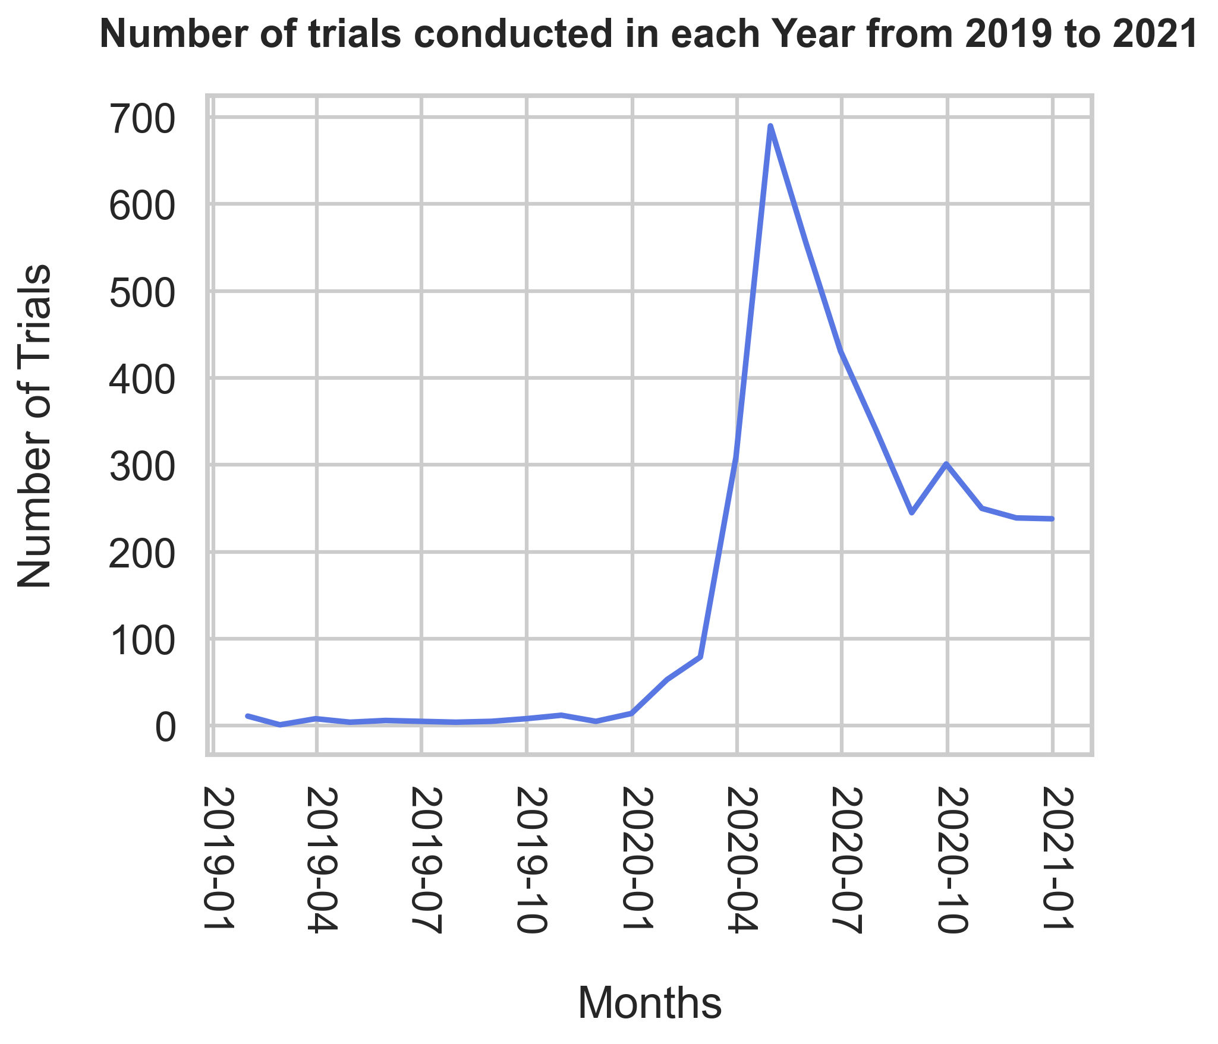
COVID-19 Clinical Trials EDA
Most dataset columns, like Rank, NCT Number, and Title, are complete. Significant missing data occurs in Results First Posted, Study Documents, Acronym, and Phases. Interventions and Locations have moderate gaps, while Outcome Measures, Study Designs, and others show minimal missing values. Targeted data handling is needed for high-missing-value columns.
python
data['Countries'] =data['Locations'].apply(extract_countries)
data['Duration']=calculate_duration(data['Start Date'],data['Completion Date’])
data['Interventions Types']=data['Interventions'].apply(extract_intervention_types)
Acronym (shorthand for study titles) or Study Documents (links to PDFs) might not be needed for our analysis then we shall remove it
Analysis (Distribution of Status of the trials)
Similarly, we can conduct on various terms such as
python
python
all_intervenion = [item for items in data['Interventions Types'] for item in items]
intervention_count = Counter(all_intervenion)
mc=pd.DataFrame(intervention_count.items(),columns=['type','count'])
mc=mc.sort_values(by='count', ascending=False)
sns.set_style('whitegrid')
# plt.figure(figsize=(12, 7))
plt.title("Most Commonly used Interventions", fontsize=16)
ax = sns.barplot(data=mc,x='type',y='count',hue="type",palette='coolwarm')
for bar in ax.patches:
height=bar.get_height()
ax.text(
bar.get_x() + bar.get_width()/2,
height + 1,
f'{int(height)}',
ha="center",va="bottom",fontsize=10
)
plt.ylabel('Number of Interventions')
plt.xlabel('Types of Interventions')
plt.xticks(rotation=-90)
plt.grid(True,linestyle="--",alpha=0.8)
plt.savefig("Most Commonly used Interventions",dpi=300,bbox_inches='tight')
plt.show()
# Flatten the list of country lists
all_countries = [country for sublist in data['Countries'] for country in sublist]
country_count = Counter(all_countries)
# Convert to DataFrame and get top 15
top15_df = pd.DataFrame(country_count.items(), columns=['Country', 'Count'])
top15_df = top15_df.sort_values(by='Count', ascending=False).head(15)
# Plotting
sns.set_style('whitegrid')
# plt.figure(figsize=(12, 7))
plt.title("Top 15 Countries by Number of COVID-19 Trials", fontsize=16)
# Barplot with hue same as x just for coloring
ax = sns.barplot(data=top15_df, x='Country', y='Count', hue='Country', dodge=False, palette='coolwarm')
# Add labels above bars
for bar in ax.patches:
height = bar.get_height()
ax.text(
bar.get_x() + bar.get_width() / 2,
height + 1,
f'{int(height)}',
ha='center', va='bottom', fontsize=10
)
# Customize
plt.ylabel("Number of Trials")
plt.xticks(rotation=90)
plt.grid(True, linestyle="--", alpha=0.9)
plt.tight_layout()
plt.savefig('Top 15 Countries by Number of COVID-19 Trials.png', dpi=300, bbox_inches='tight')
plt.show()

Slide 21
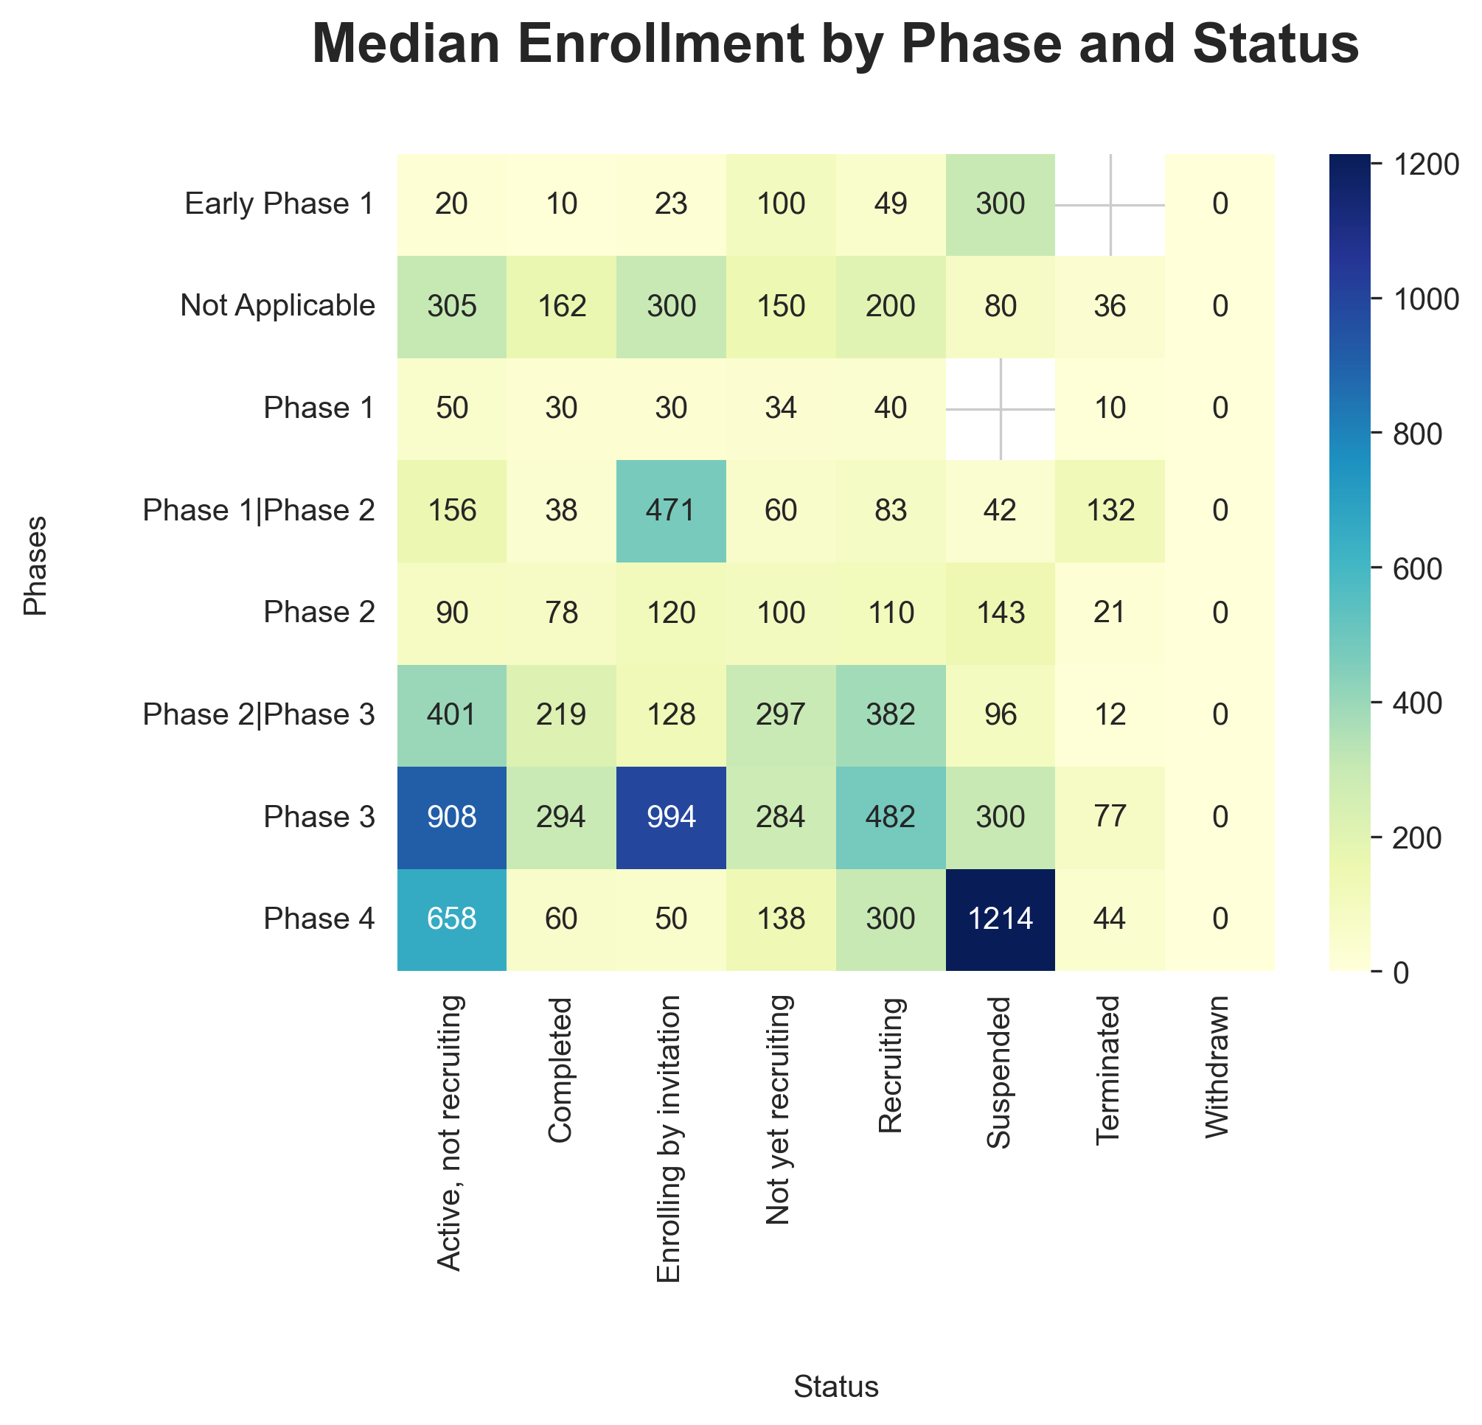
COVID-19 Clinical Trials EDA
Most dataset columns, like Rank, NCT Number, and Title, are complete. Significant missing data occurs in Results First Posted, Study Documents, Acronym, and Phases. Interventions and Locations have moderate gaps, while Outcome Measures, Study Designs, and others show minimal missing values. Targeted data handling is needed for high-missing-value columns.
python
data['Countries'] =data['Locations'].apply(extract_countries)
data['Duration']=calculate_duration(data['Start Date'],data['Completion Date’])
data['Interventions Types']=data['Interventions'].apply(extract_intervention_types)
Acronym (shorthand for study titles) or Study Documents (links to PDFs) might not be needed for our analysis then we shall remove it
Analysis (Number of trials conducted in each Year from 2019 to 2021)
Similarly, we can conduct on various terms such as

Slide 22
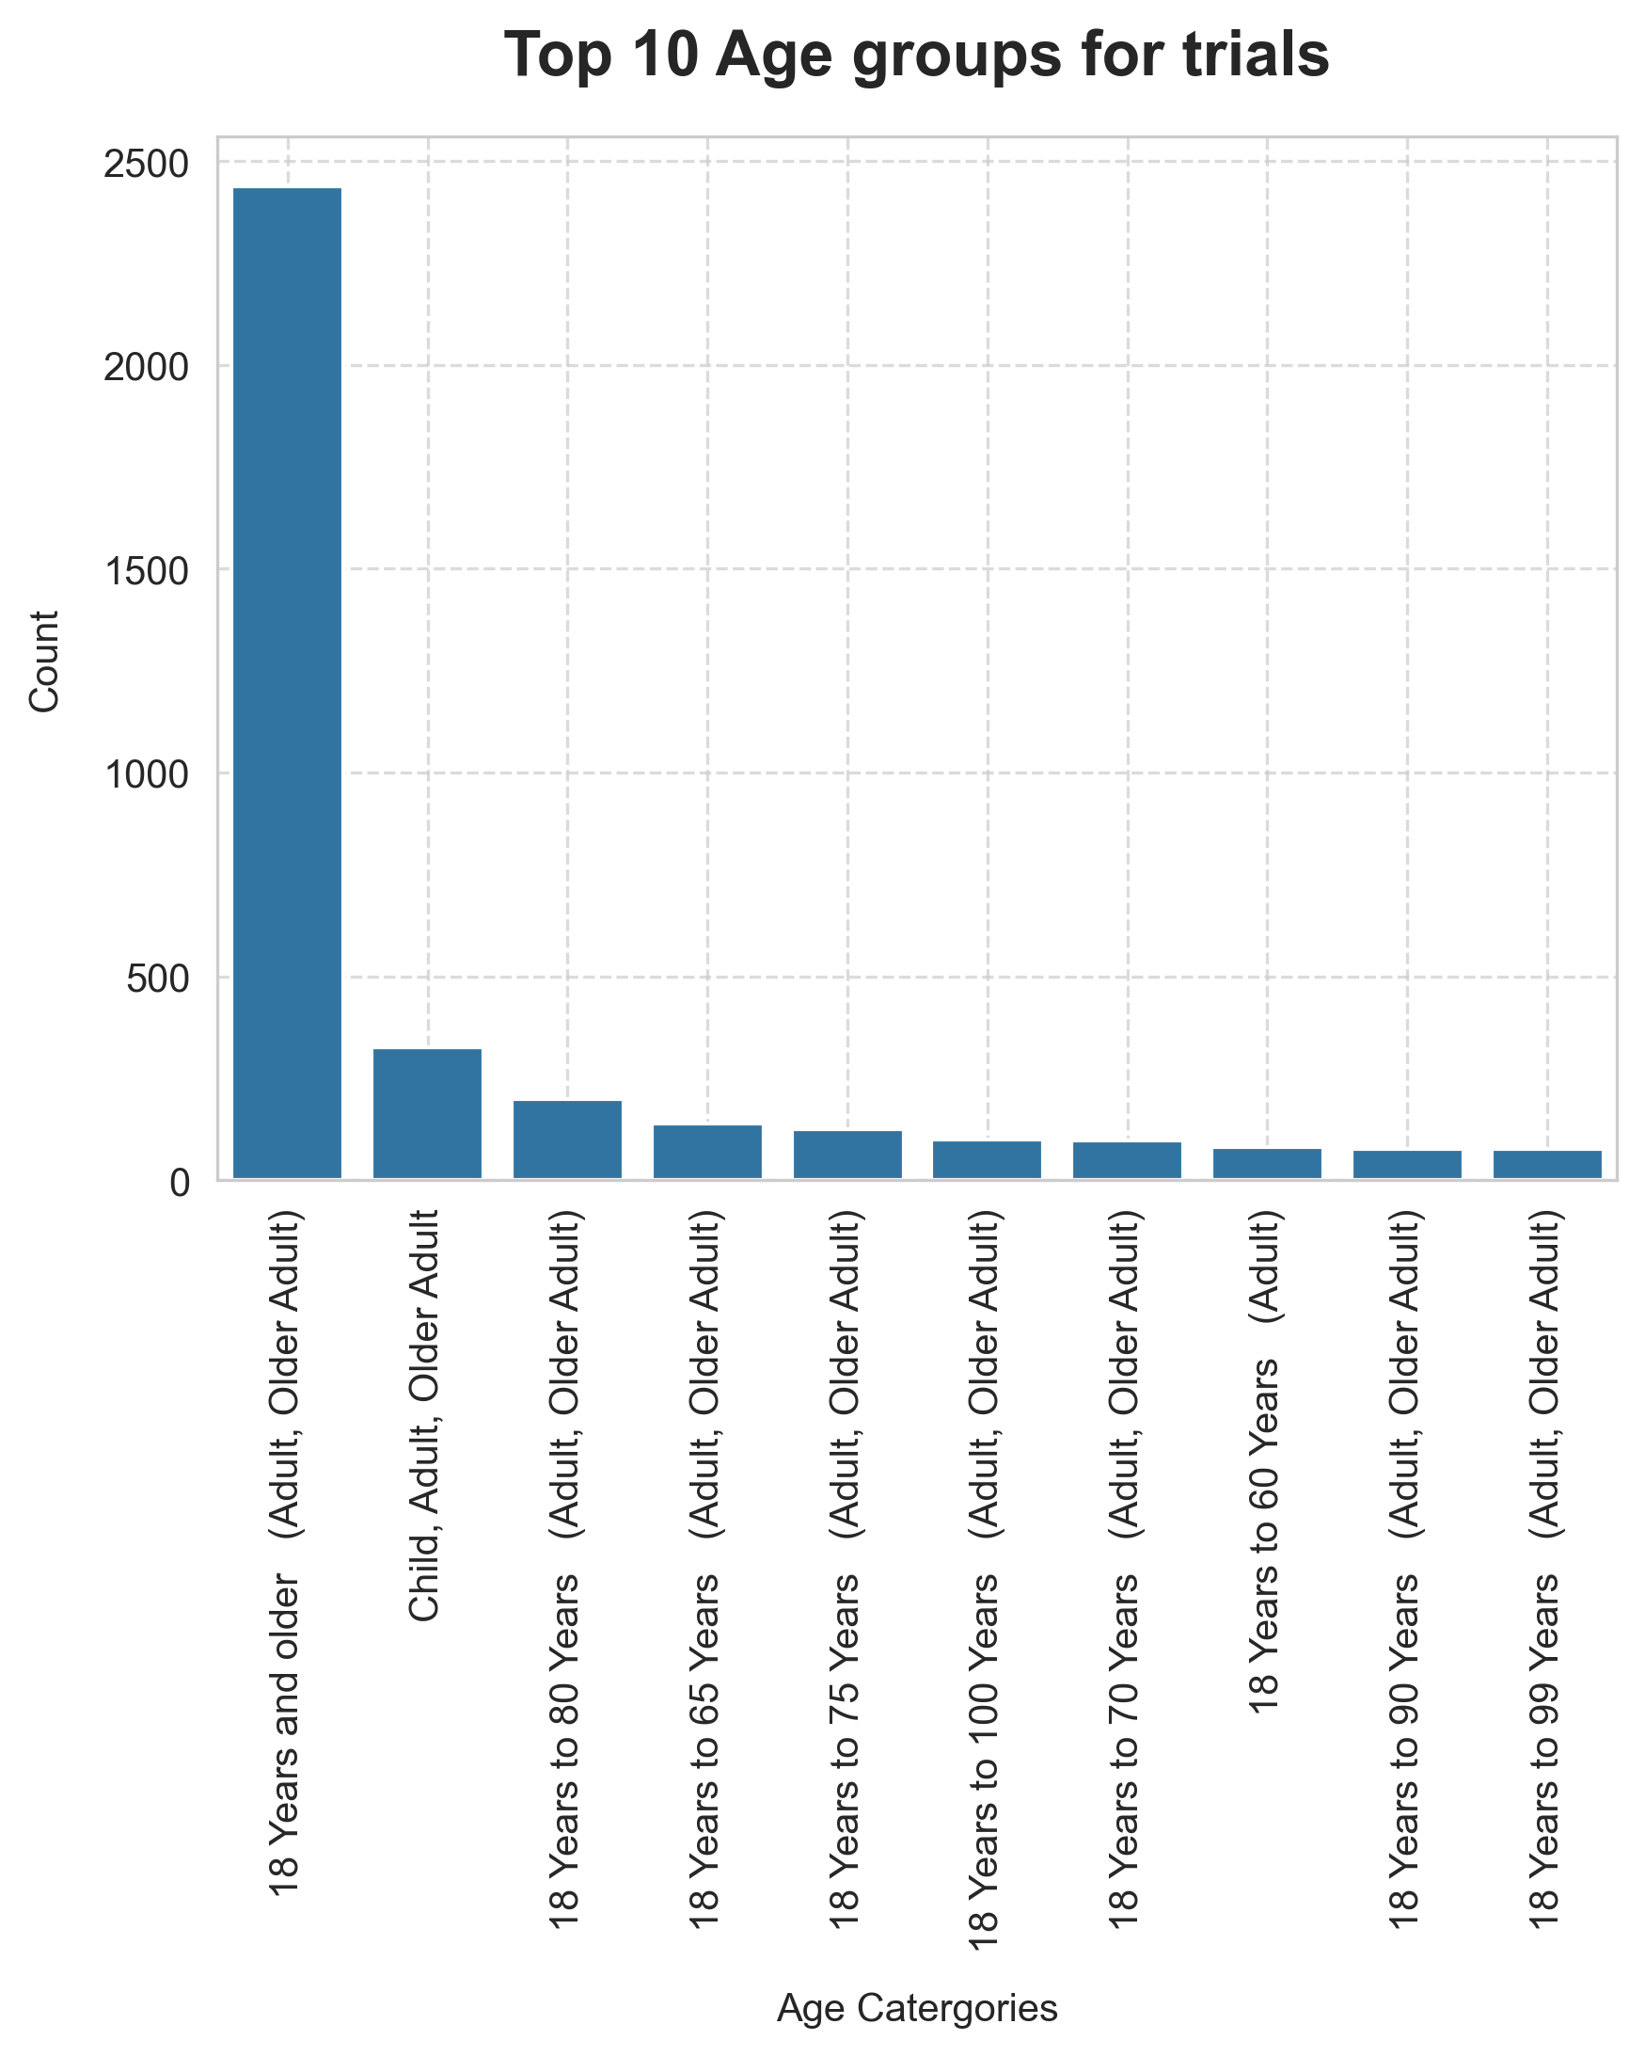
COVID-19 Clinical Trials EDA
Most dataset columns, like Rank, NCT Number, and Title, are complete. Significant missing data occurs in Results First Posted, Study Documents, Acronym, and Phases. Interventions and Locations have moderate gaps, while Outcome Measures, Study Designs, and others show minimal missing values. Targeted data handling is needed for high-missing-value columns.
python
data['Countries'] =data['Locations'].apply(extract_countries)
data['Duration']=calculate_duration(data['Start Date'],data['Completion Date’])
data['Interventions Types']=data['Interventions'].apply(extract_intervention_types)
Acronym (shorthand for study titles) or Study Documents (links to PDFs) might not be needed for our analysis then we shall remove it
Analysis (Median Enrollment by Phase and Status)
Similarly, we can conduct on various terms such as

Slide 23
COVID-19 Clinical Trials EDA
Most dataset columns, like Rank, NCT Number, and Title, are complete. Significant missing data occurs in Results First Posted, Study Documents, Acronym, and Phases. Interventions and Locations have moderate gaps, while Outcome Measures, Study Designs, and others show minimal missing values. Targeted data handling is needed for high-missing-value columns.
python
data['Countries'] =data['Locations'].apply(extract_countries)
data['Duration']=calculate_duration(data['Start Date'],data['Completion Date’])
data['Interventions Types']=data['Interventions'].apply(extract_intervention_types)
Acronym (shorthand for study titles) or Study Documents (links to PDFs) might not be needed for our analysis then we shall remove it
Analysis (Median Enrollment by Phase and Status)
Similarly, we can conduct on various terms such as

Slide 24

COVID-19 Clinical Trials EDA
Most dataset columns, like Rank, NCT Number, and Title, are complete. Significant missing data occurs in Results First Posted, Study Documents, Acronym, and Phases. Interventions and Locations have moderate gaps, while Outcome Measures, Study Designs, and others show minimal missing values. Targeted data handling is needed for high-missing-value columns.
python
data['Countries'] =data['Locations'].apply(extract_countries)
data['Duration']=calculate_duration(data['Start Date'],data['Completion Date’])
data['Interventions Types']=data['Interventions'].apply(extract_intervention_types)
Acronym (shorthand for study titles) or Study Documents (links to PDFs) might not be needed for our analysis then we shall remove it
Conclusion
This project presents a comprehensive analysis of global COVID-19 clinical trials using Python. The Jupyter Notebook demonstrates key data science skills: importing and cleaning raw trial data, parsing complex fields (like locations and dates), and extracting insights such as intervention types, enrollment distributions, and study durations. Visualizations and code logic explore patterns in trial status, geographic reach, and trial design. Combined with Tableau visuals and a presentation, this work showcases a complete data analysis pipeline from raw data to insight communication.
Analysis (Most Commonly used Intervention)
Similarly, we can conduct on various terms such as

